Slide 1

Last-Minute Shopping App
DASHBOARD CREATION AND ANALYSIS
SREYASHREE PATI
PGDA 37

Slide 2

CONTENT
INTRODUCTION
WHY CHOOSE BLINKIT
PURPOSE OF DASHBOARD:
HOW WAS THE DATA COLLECTED AND ANALYZED
KEY PERFORMANCE INDICATORS (KPIS)
SALES BREAKDOWN BY OUTLET
PRODUCT CATEGORY INSIGHTS
OUTLET ESTABLISHMENT TRENDS
KEY INSIGHTS AND OPPORTUNITIES
CHALLENGES AND SOLUTIONS
FUTURE ENHANCEMENTS
INSIGHTS AND SATISFACTION
COMPETITIVE BENCHMARKING

Slide 3

INTRODUCTION
Blinkit is India's premier last-minute delivery app, providing customers with a fast and convenient way to purchase groceries, household items, and more.
The app is designed to cater to those in need of quick deliveries, ensuring that essentials are just a click away.
Why Choose Blinkit
Fast Delivery: Get your orders delivered within minutes.
Variety of Products: Shop for groceries and daily essentials.
User-Friendly: Easy to use with reliable service.
Real-Time Updates: Track your order with live updates.

Slide 4
Purpose of Dashboard:
Objective: To analyze Blinkit’s performance in sales, inventory, and customer satisfaction.
Goal: Help make decisions based on key performance indicators (KPIs).
Focus: Shows total sales, average sales, item count, and ratings, along with sales by outlet size, location, and type.
How Was the Data Collected and Analyzed
Data Sources: The data was gathered from Blinkit’s internal sales records, customer ratings, and inventory management systems.
Data Cleaning: Ensuring accuracy and consistency was paramount, with extensive data cleaning processes implemented.

Slide 5
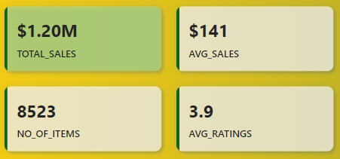
Data Modeling: Relationships between different datasets were modeled to support in-depth analysis.
Dashboard Development: DAX calculations and SQL queries were used to generate insights, which were then visualized in Power BI.
Key Performance Indicators (KPIs)
What Are the Key Metrics
Total Sales: $1.20M, reflecting Blinkit’s overall market impact.
Average Sales per Item: $141, showcasing product profitability.
Number of Items Sold: 8,523, indicating the breadth of Blinkit’s reach.
Average Customer Ratings: 3.9, highlighting customer satisfaction levels.

Slide 6
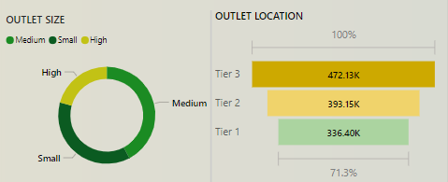
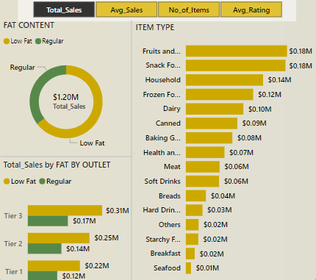
Sales Breakdown by Outlet
Characteristics
Sales Analysis by Outlet Size and Location
Outlet Size: High-sized outlets contribute to 71.3% of total sales, indicating the importance of larger outlets in Blinkit’s strategy.
Outlet Location: Tier 3 locations lead in sales, followed by Tier 2 and Tier 1, suggesting a strong presence in less urbanized areas.
Product Category Insights
Sales by Item Type and Fat Content
Top-Selling Categories: Fruits and snacks are the leading product categories, with regular fat content products contributing significantly to total sales.
Strategic Focus: These insights suggest that Blinkit should continue to focus on popular product categories to maximize sales.

Slide 7
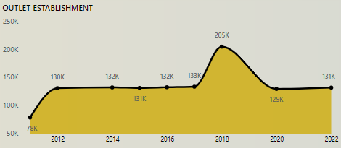
Outlet Establishment Trends
Growth and Trends in Outlet Establishment
Establishment Growth: The dashboard reveals a sharp increase in outlets in 2018, followed by a stabilization, reflecting Blinkit’s expansion strategy.
Market Impact: This growth aligns with Blinkit’s goal to increase its market footprint, particularly in high-performing regions.
Key Insights and Opportunities
What Are the Key Takeaways
High-Performing Outlets: Focus on optimizing operations in High-sized outlets and Tier 3 locations for maximum revenue.
Product Optimization: Continue promoting top-selling categories while exploring underperforming areas for growth.
Opportunities: The dashboard identifies potential bottlenecks and areas for improvement, guiding Blinkit’s strategic decisions.

Slide 8
Conclusion and Next Steps
Dashboard Impact: This dashboard empowers Blinkit with actionable insights, helping to optimize sales strategies and improve customer satisfaction.
Future Actions: Leverage these insights to refine product offerings, enhance customer experience, and expand market presence.

Slide 9
Challenges and Solutions
Challenges Faced and How We Addressed Them
Data Integration: Integrating data from multiple sources was challenging, but it was addressed by developing robust data cleaning and validation processes.
Data Quality: Ensuring data accuracy was crucial for reliable analysis. Regular data quality checks were implemented to maintain high standards.
User Adoption: To ensure stakeholders could effectively use the dashboards, training sessions were provided, and user-friendly interfaces were designed.
Future Enhancements
Future Enhancements and Expansion Plans
Dynamic Reporting: Plans to incorporate real-time data feeds to provide even more up-to-date insights.
Predictive Analytics: Exploring the integration of AI-driven predictive analytics to forecast sales trends and customer behavior.
Market Expansion: Consideration for expanding the analysis to include international markets as Blinkit scales its operations.

Slide 10
Insights and Satisfaction
Customer Deep Dive into Customer Satisfaction
Customer Feedback: Analysis of customer ratings and feedback to identify areas of improvement and enhance user experience.
Ratings Breakdown: Detailed look at the average rating of 3.9, identifying patterns in customer satisfaction across different regions and product categories.
Action Plan: Outline of strategies to improve customer satisfaction, such as targeted promotions, enhanced product offerings, and improved delivery times.
Competitive Benchmarking
Competitive Analysis and Market Positioning
Benchmarking: Comparison of Blinkit’s performance metrics with industry competitors to assess market positioning.
Strengths: Identification of Blinkit’s competitive advantages, such as rapid delivery and a broad product range.
Opportunities: Areas where Blinkit can improve to gain a competitive edge, such as expanding to new regions or enhancing app features.

Slide 11
Customization and Personalization
Personalization Strategies for Enhanced Customer Experience
Data-Driven Personalization: Using insights from the dashboard to tailor product recommendations and marketing efforts based on customer preferences.
User Segmentation: Analyzing customer data to create targeted segments for more personalized offers and promotions.
Impact: Expected outcomes include increased customer loyalty and higher average order values.
Executive Summary Recap
Recap and Key Takeaways
Summary: Brief recap of the most critical insights and strategies discussed in the presentation.
Key Takeaways: Reinforce the importance of data-driven decision-making and how the dashboard contributes to Blinkit’s growth and customer satisfaction.

Slide 12
